Slide 1
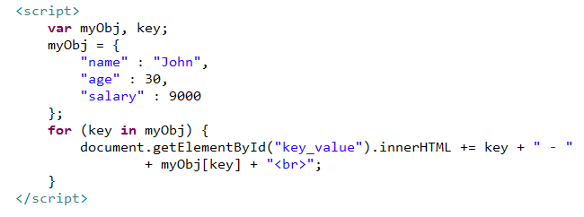
JSON - Looping an Object
We can loop through object properties by using the for-in loop, In a
for-in loop, use the bracket notation to access the property values:

